Slide 1

Introduction to Entrepreneurship
Dr. Zunaira Saqib

Slide 2

Week 5: Pitching and Industry Analysis
Learning to Pitch Your Ideas
Industry Analysis Pakistan

Slide 3
Startup Ideas
Problem
Solution
USP (Unique Selling Proposition)
Industry Analysis

Slide 4

Industry Analysis and USP
Industry Analysis
Understanding Basic Industry Stats
Porter’s Five Forces
USP
Generic Strategies
Unique Selling Points

Slide 5

Industry Analysis Pakistan
Understand the environment you are operating in

Slide 6

Why Industry Analysis?
Know the market you are operating in
Understand the opportunities
Understand the challenges

Slide 7

Medicine / Pharmacy Industry
Consistent growth over the years (USD 3.2 billion – 15% annual growth)
The Drug Regulatory Authority of Pakistan (DRAP)
Key Players:
Ferozsons Laboratories
GlaxoSmithKline Pakistan
Abbott Laboratories Pakistan
Getz Pharma
Challenges:
Counterfeit Medicines
Price Control
Intellectual Property Issues
Opportunities:
Export Potential

Slide 8

Software Industry
Market size was estimated to be in the range of $3 Billion
Key Players:
Systems Limited
Netsol Technologies
10Pearls
Outsourcing and Services
IT Parks and Hubs
Challenges:
Infrastructure
Skills Gap
Intellectual Property Protection
Opportunities:
Export Potential
Government Initiatives

Slide 9
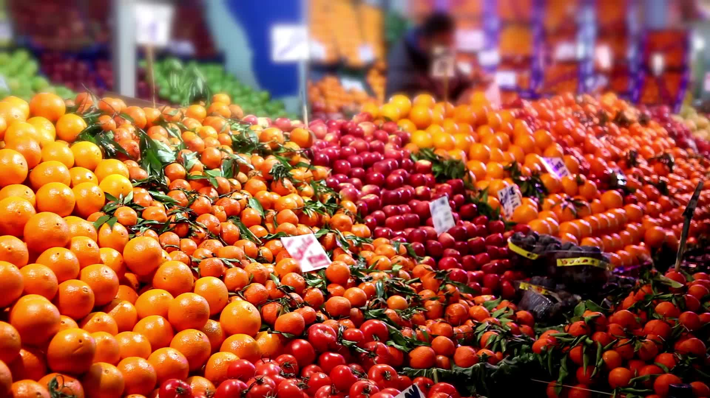
Food Industry
One of the largest and most diverse sectors of the economy ($114 billion)
Segments: agriculture, processed foods, beverages, dairy, and restaurants.
Key Players:
Nestlé Pakistan
Engro Foods (now owned by FrieslandCampina)
Shan Foods
Trends and Consumer Preferences:
Convenience Foods
Health and Wellness
E-commerce
Challenges:
Supply Chain Issues
Price Sensitivity

Slide 10
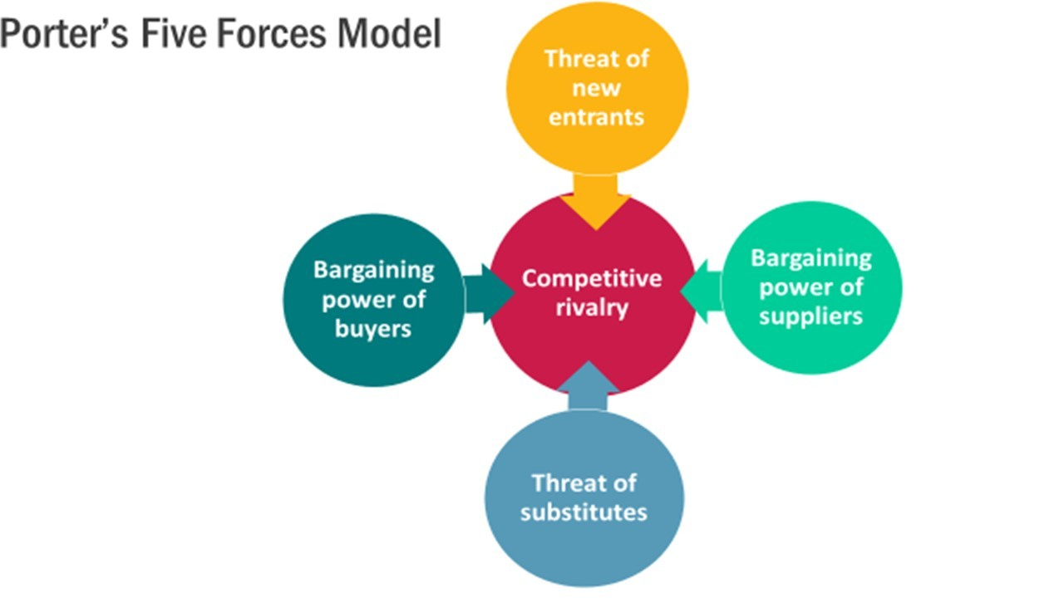
Porter’s Five Forces

Slide 11
Competitive Rivalry
One of the most important
Increase in pressure, time and cost!
Factors
Number of Competitors
Market Size
Product differentiation
Power of buyers
Capacity utilization
Cost structure
Exit barriers

Slide 12
The threat of entry
Involves organisations entering into an industry whereby they will gain market share and competition will intensify
Barriers to entry
Economies of scale
Product differentiation – Loyalty (Shugan, 2005)
Capital Requirements
Cost disadvantages
Raw materials
Favorable locations
Government subsidies
Distribution channels (Grimm, 2006)
Notes:
Loyalty is considered as a barrier to entry because some organisations have high degrees of brand loyalty and their consumers stay loyal to a product and their chosen organisation. The consumer becomes attached to the brand over time (Shugan, 2005)
Capital requirements create barriers because organisations require financial resources to operate such as infrastructure, employees, research and development, advertising and sales

Slide 13




Buying power
Customers who collectively become a powerful group
Exert pressure
Drive down prices
Increase the quality of good
Notes:
An example of such extreme buying power in the UK is the dominant supermarkets, Tesco, Sainsbury's, Morrison's and Asda (known as the ‘Big 4’). The Big 4 are able to exert great power over their suppliers, for example, what food is grown and how it is processed and packaged (Consumers International, 2012).

Slide 14

Supplier power
The suppliers have power to sell their products at higher prices.
Example: Suppliers to Fast Food Restaurants (Halal)
Notes:
An interesting example of supplier power is fast food restaurants. Fast food restaurants depend heavily on their suppliers for the basics of making their business successful - food products, packaging, furniture, napkins, crockery etc.
Given this, potential new entrants to the fast food industry should then consider the level of influence and bargaining power of their suppliers because if the suppliers have high levels of influence in the industry, then future projections and growth strategies need to be accounted for due to the likelihood of price increases.

Slide 15
Threat of substitutes
“A substitute performs the same or a similar function as an industry’s product by a different function . . . [and] limit an industry’s profit potential by placing a ceiling on prices” (Porter, 2008: 84).
Extent depends on:
Switching costs
Product price
Product quality

Slide 16
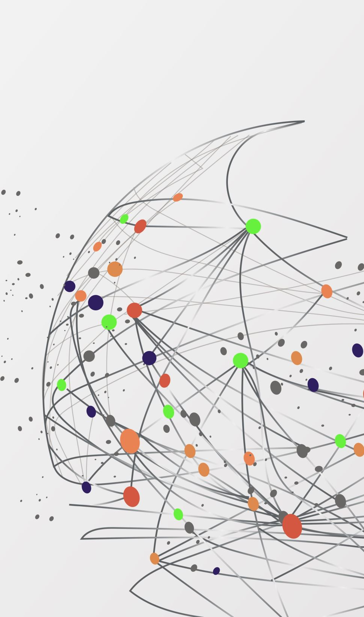
Unique Selling Preposition / Point (USP)
Porter’s Generic Strategies

Slide 17
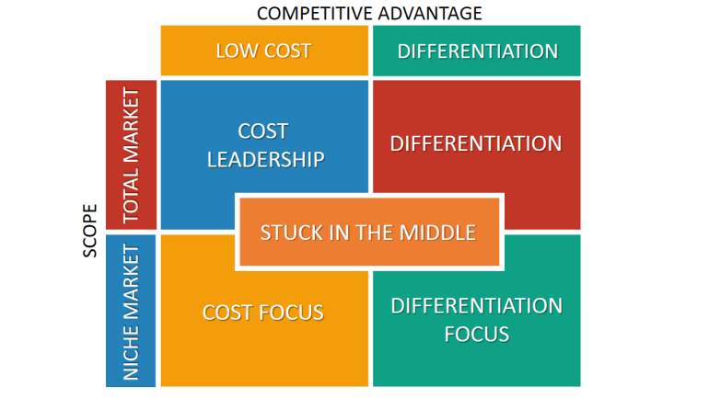
Porter’s Generic Strategies

Slide 18
Cost Leadership
Focuses on gaining competitive advantage by having the lowest cost in the industry
Aim
To service mass market
Techniques
Mass production
Mass distribution
Economies of scale
Technology
Product design

Slide 19
Differentiation
Concentrates on providing a unique product or service, developing a unique selling point (USP) to ensure they are different from their competitors
Tailoring to individual customer segments
Techniques
Extra features
Quality
Price

Slide 20
Focus/Differentiation Focus
Concentrates on a selected few target markets (focus) or seeks differentiation in its target segment
Aim
Gain a competitive advantage through effectiveness rather than efficiency
Techniques
Being clear in differences with competition
Being clear in differences with other consumers
Niche status

Slide 21

Pitching Your Ideas
How to Pitch Your Ideas?

Slide 22

The Start up Idea Pitch
A startup idea is a hypothesis for why your company is going to grow really quickly.
Three different parts
The problem
The solution
The insight

Slide 23
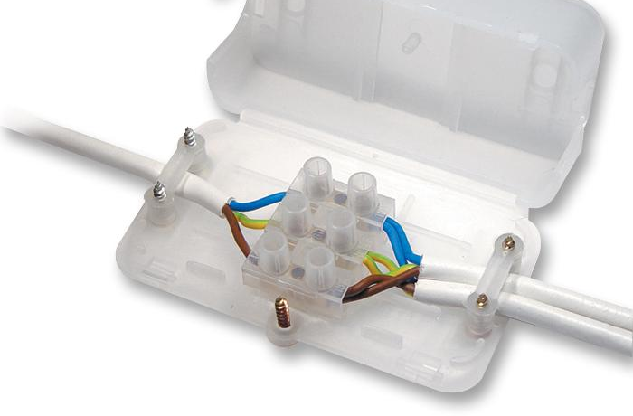
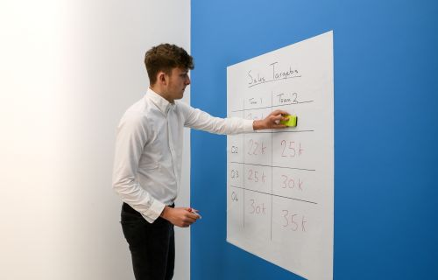
Different ways to pitch
Tell a story
AI based diagnosis
Focus on facts
Career counselling problem
Focus on unique technology
Magic Whiteboard
Wonderly (Technology and publishing business that produces personalized books for children and adults)
Chocbox (patented plastic box for safely enclosing electrical connections)

Slide 24

Important to Remember
Your problem should be pretty big
Very big market / A lot people have the problem
You should not start with a technology, you should start with a problem
What makes your company unique
Some kind of unfair advantage
KNOW YOUR AUDIENCE – WHO ARE YOU PITCHING ?

Slide 25

Your startup / Business ideas
Present 3 ideas – 2 minute for each idea (6 minutes in total)
Problem (30 seconds)
Solution (1 Minute)
Unique Selling Proposition (USP) and Industry Analysis (30 Seconds)

